Slide 1
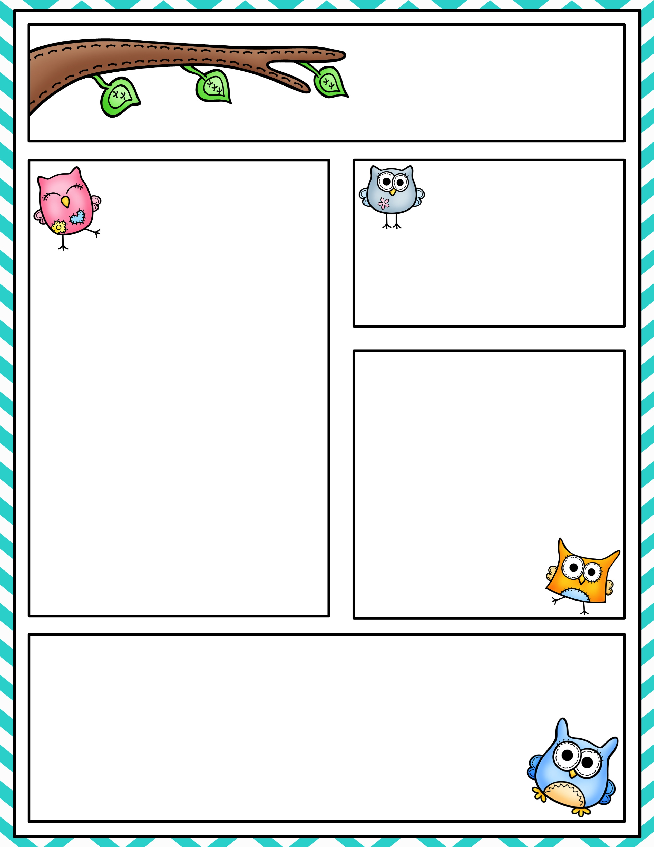
Mrs. Sampogne’s
Kindergarten Newsletter
November 27- December 1
Kindergarten News
December Birthdays
I hope everyone had a happy and healthy Thanksgiving! We are looking forward to many exciting things happening in December!
This week, we will continue our Fundations and Fountas & Pinnell reading programs. In Fundations this week, we will focus on the letters v, w. We will learn the letter names, sounds, and how to properly form them! We will review t, b, f, n, m, i, u, c, o, a, g, d, s, e, r, p, j, h, k, l. In F&P, we will continue to learn all about wordless picture books. We will focus on the sight words, “six, seven, eight, nine, ten.” Please practice reading/writing them at home EVERY SINGLE NIGHT.
In Math, we will begin our seventh unit, “Count and Represent Numbers Through Eight.” Students will be able to identify numbers 6, 7, 8, show different ways to make 6, 7, 8, and form 6, 7, 8. Please reinforce these concepts at home!
We will visit the PTA holiday sale on Thursday, 11/30 only. Please send your child with money if they intend to buy something!
If you need to contact me, please e-mail me at ssampogne@franklinsquare.k12.ny.us or
Mrs. Sampogne
No December Birthdays!
Homework
Monday: Go Math p. 235 & 236
Tuesday: Go Math p. 241 & 242
Wednesday: Go Math p. 247 & 248
Thursday: Go Math p. 253 & 254
Friday:
Upcoming Events
11/27 Toy Drive begins!
11/30 Holiday Sale (we visit!) send $$ with your child!
12/7 Report Cards on portal!
12/8 5th Grade Bake Sale (we visit) send $$!!
12/9 PTA Holiday Brunch
Sight words (read and write them)
Review: New:
I ,can, the, #1-5, we, like, a six, seven, eight, nine, ten
To, and, do, my, me

